Slide 1
UNIT-FOUR
PART-THREE

Slide 2
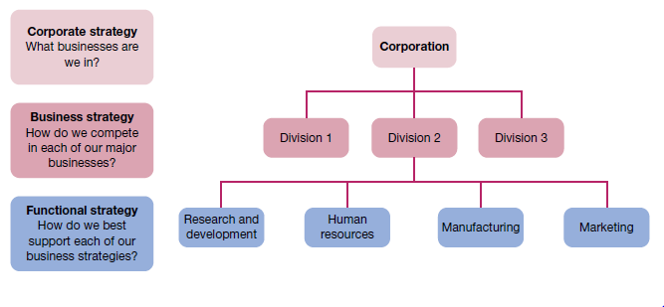
Levels of strategy in organisations

Slide 3
Levels of strategy
The level of corporate strategy directs the organisation as a whole towards sustainable competitive advantage. For a business it describes the scope of operations by answering the following question: In what industries and markets should we compete? The purpose of corporate strategy is to set direction and guide resource allocations for the entire enterprise.

Slide 4
Business strategy
Business strategy is the strategy for a single business unit or product line. It describes intent to compete within a specific industry or market.
The term strategic business unit (SBU) is often used to describe a single business or a component that operates with a separate mission within a larger enterprise. The selection of strategy at the business level involves answering the question: How are we going to compete for customers in this industry and market?

Slide 5
Functional strategy
Functional strategy guides the use of organisational resources to implement business strategy. This level of strategy focuses on activities within a specific functional area of operations. The standard business functions of marketing, manufacturing, human resources, and research and development illustrate this level of strategy. The question to be answered in selecting functional strategies becomes: How can we best use resources to implement our business strategy? Answers to this question typically involve the choice of progressive management and organizational practices that improve operating efficiency, product or service quality, customer service or innovativeness.

Slide 6
Growth and diversification strategies
One approach to growth is through concentration, where expansion is within the same business area.
Another approach to growth is through diversification, where expansion takes place through the acquisition of, or investment in, new and sometimes different business areas.
Diversification can also take the form of vertical integration, where a business seeks added value creation by acquiring suppliers (backwards vertical integration) or distributors (forwards vertical integration).

Slide 7
Restructuring and divestiture strategies
The most extreme retrenchment strategy is liquidation,
Less extreme but still of potential dramatic performance impact is restructuring
Restructuring is sometimes accomplished by downsizing, which decreases the size of operations with the intention of becoming more streamlined. The expected benefits are reduced costs and improved operating efficiency.
Retrenchment with a strategic focus is sometimes referred to as rightsizing. This contrasts with the less well regarded approach of simply cutting staff ‘across the board’.
Restructuring by divestiture involves selling off parts of the organisation to refocus on core competencies, cut costs and improve operating efficiency.

Slide 8
Cooperation in business strategies
The growth of strategic alliances and other forms of cooperative strategy between companies, particularly in technology and marketing. For Porter and Fuller, the basic motivation for an alliance is that: ‘Coalitions that arise when performing a value chain activity with a partner are superior to any other way . . . Coalitions can be a valuable tool in many aspects of global strategy, and the ability to exploit them will be an important source of international advantage.
International joint ventures are common form of international business; they constitute one among many forms of strategic alliance.

Slide 9
E‐business strategies
e‐business strategy is the strategic use of the internet to gain competitive advantage. Popular e‐business strategies involve B2B (business‐to‐business) and B2C (business‐to‐customer) applications. B2B business strategies involve the use of IT and the internet to vertically link organisations with members of their supply chains. One of the interesting developments in this area involves the use of online auctions as a replacement for preferred supplier relationships and outsourcing alliances.
B2C business strategies use IT and the internet to link organisations with their customers. A common B2C strategy is e‐tailing; that is, the sale of goods directly to customers via the internet.

Slide 10
Strategy formulation
Sustainable competitive advantage. The major opportunities for competitive advantage are found in the following areas:
i. cost and quality — where strategy drives an emphasis on operating efficiency and/or product or service quality
ii. knowledge and speed — where strategy drives an emphasis on innovation and speed of delivery to market for new ideas
iii. barriers to entry — where strategy drives an emphasis on creating a market stronghold that is protected from entry by others
iv. financial resources — where strategy drives an emphasis on investments and/or loss sustainment that competitors can’t match.

Slide 11
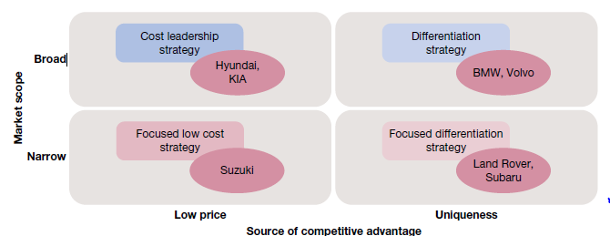
Porter’s generic strategies framework: motor vehicle industry examples

Slide 12
According to Porter, business‐level strategic decisions are driven by two basic factors: (1) market scope and (2) source of competitive advantage — ask: ‘How will you compete for competitive advantage, by lower price or product uniqueness?’

Slide 13
i. differentiation — where the organisation’s resources and attention are directed towards distinguishing its products from those of the competition (e.g. BMW, Volvo)
ii. cost leadership — where the organisation’s resources and attention are directed towards minimising costs to operate more efficiently than the competition (e.g. Hyundai, KIA)
iii. focused differentiation — where the organisation concentrates on one special market segment and tries to offer customers in that segment a unique product (e.g. Land Rover, Subaru)
iv. focused cost leadership — where the organisation concentrates on one special market segment and tries in that segment to be the provider with lowest costs (e.g. Suzuki)

Slide 14
Organisations pursuing a differentiation strategy seek competitive advantage through uniqueness. They try to develop goods and services that are clearly different from those made available by the competition.

Slide 15
Organisations pursuing a cost leadership strategy try to continuously improve the operating efficiencies of production, distribution and other organisational systems. The objective is to have lower costs than competitors and therefore achieve higher profits.

Slide 16
Organisations pursuing a focused differentiation strategy or a focused cost leadership strategy concentrate attention on a special market segment with the objective of serving its needs better than anyone else.

Slide 17
Product life cycle planning
Another way to consider the dynamic nature of business strategy formulation is in terms of product life cycle.
lifecycle stages of new product development, introduction, growth, maturity and decline.

Slide 18
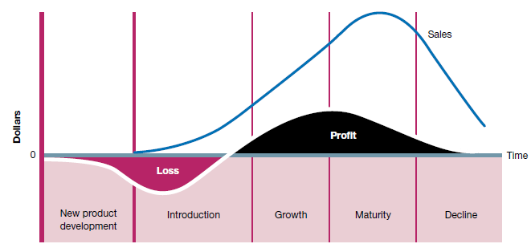
The product life cycle

Slide 19
Portfolio planning
choose between alternative shares, bonds and real estate in a personal investment portfolio. In multi‐business situations, strategy formulation also involves portfolio planning to allocate scarce resources among competing uses.

Slide 20
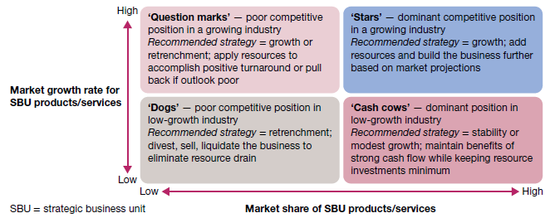
The BCG matrix approach to corporate strategy formulation

Slide 21
Adaptive strategies
The prospector strategy involves pursuing innovation and new opportunities in the face of risk and with prospects for growth.
Defender strategy, in which an organisation avoids change by emphasising existing products and current market share without seeking growth. Defence as a strategy is suited only for a stable environment and perhaps declining industries.
The analyser strategy seeks to maintain the stability of a core business while exploring selective opportunities for innovation and change
A reactor strategy are mainly responding to competitive pressures in order to survive.

Slide 22
Incrementalism and emergent strategy
Incrementalism, whereby modest and incremental changes in strategy occur as managers learn from experience and make adjustments
Effective managers must have the capacity to stay focused on long‐term objectives while still remaining flexible enough to master short‐term problems and opportunities as they occur. Such reasoning has led Mintzberg to identify what he calls emergent strategies.

Slide 23
Strategy implementation
Management practices and systems
The rest of Management is all about strategy implementation.
Failures of substance reflect inadequate attention to the major strategic planning elements
Failures of process reflect poor handling of the ways in which the various aspects of strategic planning were accomplished.

Slide 24
Corporate governance
Corporate governance is the system of control and performance monitoring of top management that is maintained by boards of directors and other major stakeholder representatives.
, corporate governance is enacted by boards, institutional investors in a company’s assets, and other ownership interests. Each in its own way is a point of accountability for top management.

